Slide 1

Lead Scoring Case Study
By,
Shubham Khandelwal

Slide 2

Introduction
Following are the goals of this case study
To build a logistic regression model to assign a lead score between 0 and 100 to each of the leads which can be used by the company to target potential leads. A higher score would mean that the lead is hot, i.e. is most likely to convert whereas a lower score would mean that the lead is cold and will mostly not get converted.
There are some more problems presented by the company which the model should be able to adjust to if the company's requirement changes in the future.

Slide 3
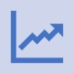




Problem Statement
Build a logistic regression model to assign a lead score between 0 and 100 to each of the leads where the leads with higher lead score have a higher conversion chance and the leads with lower lead score have a lower conversion chance
To help X education to select the most promising leads known as ‘hot leads’ who are most likely to convert into paid customers
Identify the driver variables and understand their significance which are strong indicators of lead conversion
Identify the outliers, if any, in the dataset and justify the same
Consider both technical and business aspects while building the model
Summarize the conversion predictions by using evaluation metrics like accuracy, sensitivity, specificity and precision

Slide 4
Business Goal
X Education needs help in selecting the most promising leads, i.e. the leads that are most likely
to convert into paying customers.
The company needs a model wherein you a lead score is assigned to each of the leads such that the customers with higher lead score have a higher conversion chance and the customers with lower lead score have a lower conversion chance.
The CEO, in particular, has given a ballpark of the target lead conversion rate to be around 80%.

Slide 5



Solution Methodology : Data Exploration
Leads csv contains all the information about the leads generated through various sources and their activities
.
This file contains 9240 rows and 37 columns
Out of 37 columns, 7 are numeric columns and 30 are non-numeric or categorical columns
‘Leads Data Dictionary csv’ is data dictionary which describes the meaning of the variables present in the “ dataset

Slide 6
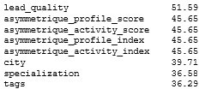
Solution Methodology : Data Cleaning and Preparation
Leads.csv:
➢ Following columns have more than 30% of null values
Check and handle duplicate data.
Columns have default value of ‘select’ as a dominating value which is same as null value So, we have converted ‘ select’ to ‘NA’
Check and handle NA values and missing values.
Drop columns, if it contains large number of missing values and not useful for the analysis.
Imputation of the values, if necessary.

Slide 7





Solution Methodology : Data Cleaning and Preparation
Columns with too many NA values cannot be imputed and so it’s better to drop them and for those that follow a standard distribution will be imputed with median.
Few columns have less than 2% na values. We can afford to drop their respective rows altogehter.
There are too many NA values with no logical way to impute in these columns so we will drop them entirely
Check and handle outliers in data.

Slide 8







Solution Methodology : EDA and Findings
Univariate data analysis: value count, distribution of variable etc.
Bivariate data analysis: correlation coefficients and pattern between the variables etc.
Feature Scaling & Dummy Variables and encoding of the data.
Classification technique: logistic regression used for the model making and prediction.
Validation of the model.
Model presentation.
Conclusions and recommendations.

Slide 9


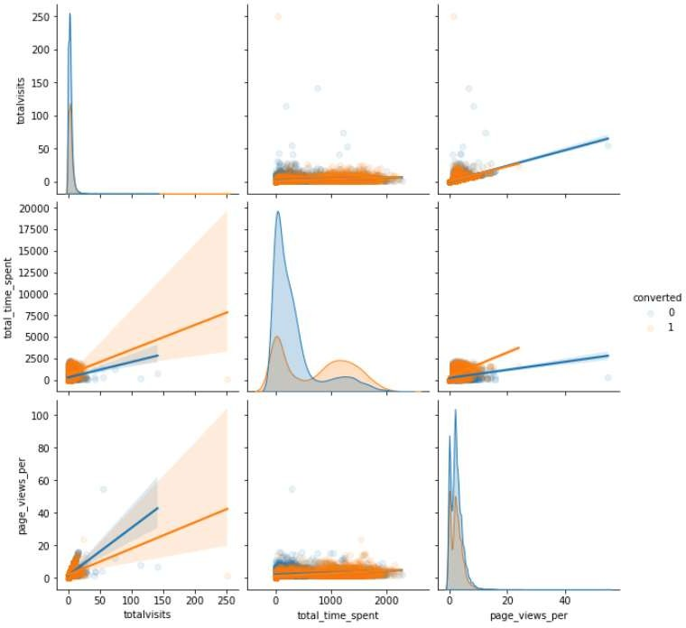
Pair plot to check the correlation between variables

Slide 10
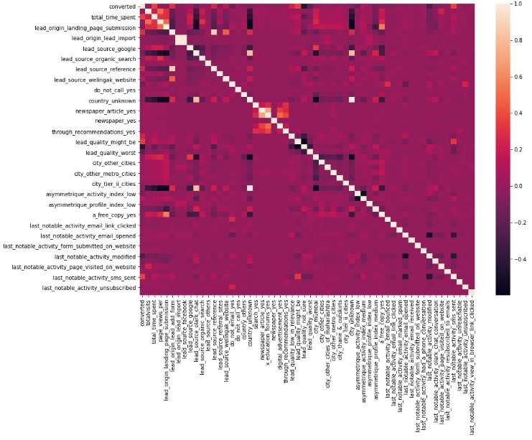

Visualizing correlation by heatmap
I nference:
Following group of columns are positively highly correlated with each other:
Search
Newspaper Article
X Education
Digital Advertisement
Through Recommendations
Another set of columns are also positively highly correlated with each other:
TotalVisits
Total Time Spent on Website
Page Views Per Visit
There is a strong positive correlation between Asymmetrique Activity Index and Asymmetrique Profile Index.

Slide 11
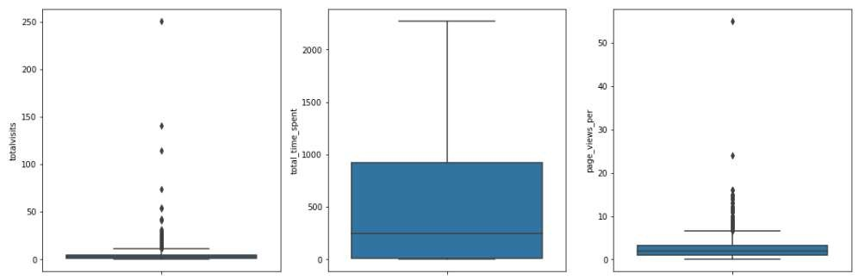
Box plot to check outliers in the data set
Inference:
T otal visits
The median is low as between 0 to 1.
Here we can see few outliers beyond 50
T otal time spent
The median lies between 0 to
500. Leads spending more time on the website are more likely to be converted.
Website should be made more engaging to make leads spend more time.
P age view per visit
The median lies between 0 to 10.
The leads are more concentrated in the range between 9 to 20
Here we can also see that there are a couple of outliers when the page views is beyond 20.

Slide 12
Univariate Analysis For Categorical Columns and Numerical Columns

Slide 13
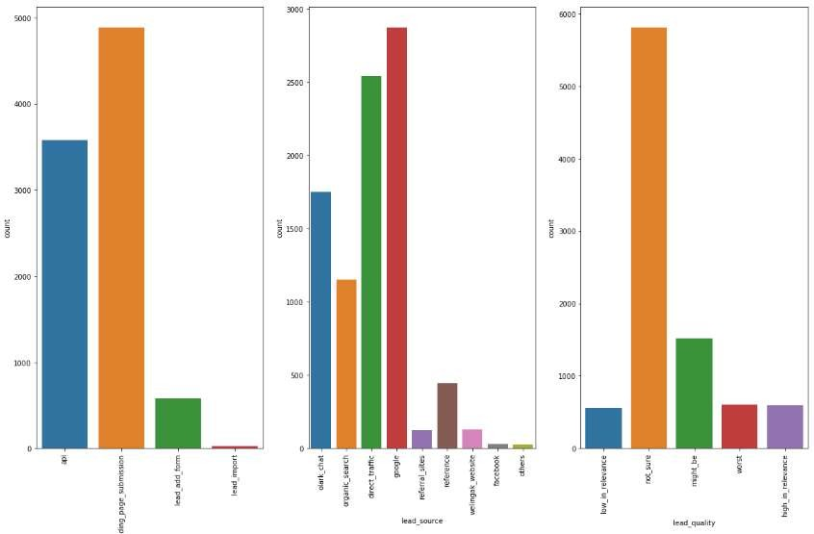
Univariate Analysis for Categorical Columns
I nference
API and Landing Page Submission bring higher number of leads as well as conversion.
Lead Import and Quick Add Form get very few leads.
In order to improve overall lead conversion rate, we have to improve lead converion of API and Landing Page Submission origin and generate more leads from Lead Add Form.

Slide 14
Univariate Analysis for Categorical Columns
Inference
Maximum number of leads are generated by Google and Direct traffic.
Conversion Rate of reference leads and leads through welingak website is high.
To improve overall lead conversion rate, focus should be on improving lead converion of olark chat, organic search, direct traffic, and google leads and generate more leads from reference and welingak website.
For Lead quality, the highest number of leads is for not_sure and the least being 3 categories
i.e. low in relevance, worst and
high in relevance

Slide 15
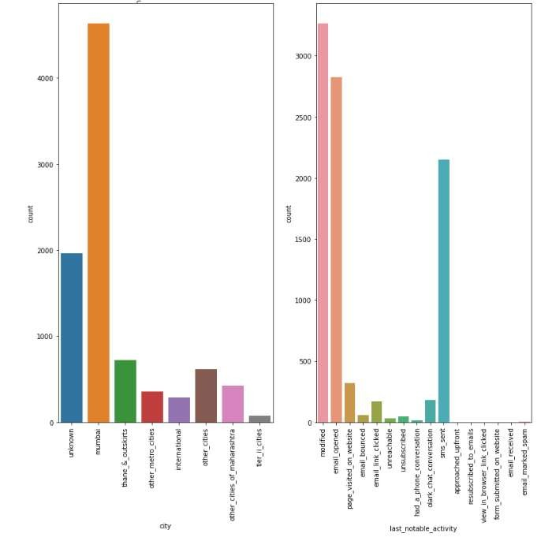
Univariate Analysis for Categorical Columns
I nference
The number of leads is highest for Mumbai and least for international followed by tier 2 cities
The number of leads for the category last notable activity is highest for modified and least foe had a phone conversation.
Other categories like resubscribed to emails, view in browser link clicked , email, maeked spam etc have no leads

Slide 16


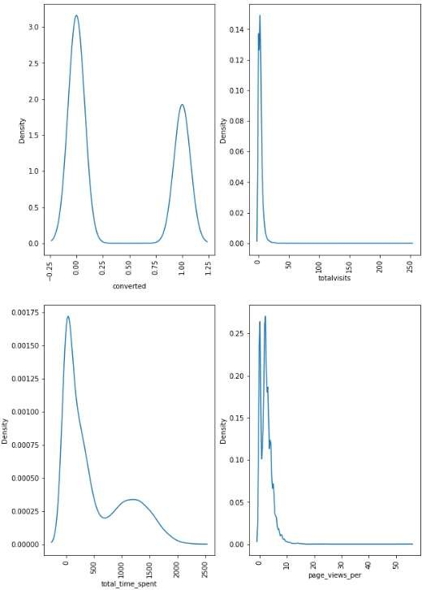
Plotting Dist plot for Numeric Columns
Inference:
The conversion rate is high when the no of total visits falls between 0 to 20(approx.) beyind which there is no conversion.
The conversion rate can be seen increasing for the total time spent at the point of origination, it increases and is at its peak between 0 to 500 and further starts falling and the curve is flat once the total time spent falls beyond 2000.
Page views have a ‘zero’ conversion rate in the band within the band 0 to 10 , post which it declines to zero.

Slide 17
Bivariate Analysis For Categorical and Numeric Variables

Slide 18
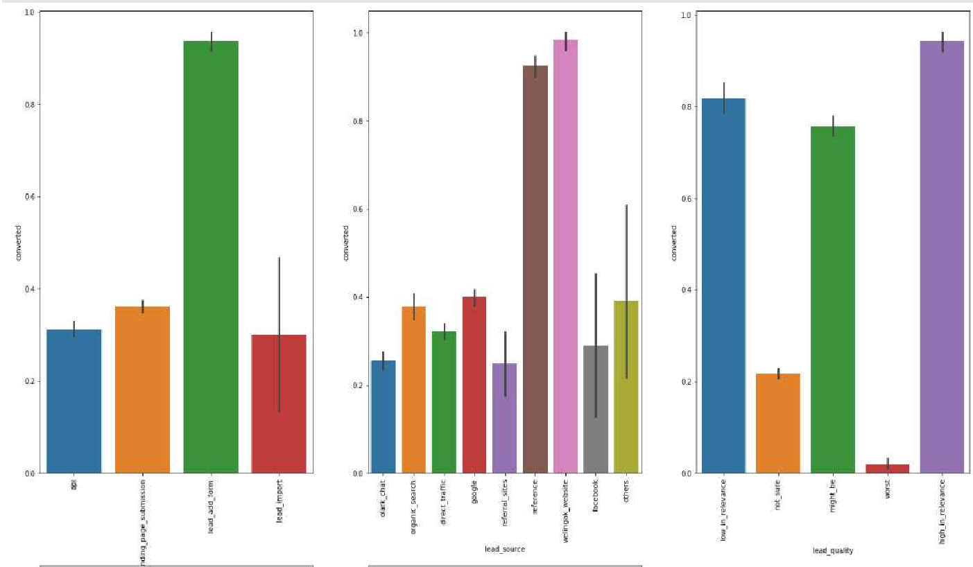
Bivariate Analysis For Categorical variables
I nference:
In Lead Origin, maximum conversion happened from lead add form whereas API was the least.
In the Lead Source, major conversion is from wellingak website.
In terms of lead quality, high in relevance has the highest conversion wherein worst tends to be lowest.

Slide 19
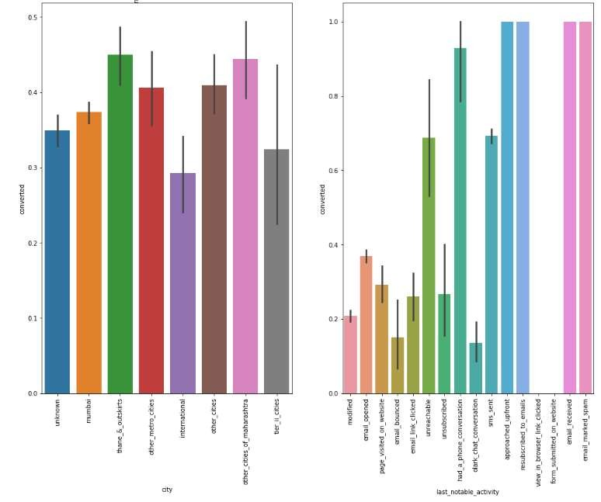
Bivariate Analysis For Categorical variables
I nference:
For the category city, Thane and outskirts has the highest conversion and International being the least.
With regard to last notable activity , approached upfront, resubscribed to emails, email received, email marked spam ; seem to have the same conversion rate.
However view in browser link clicked and form submitted on website have zero conversion rate.

Slide 20
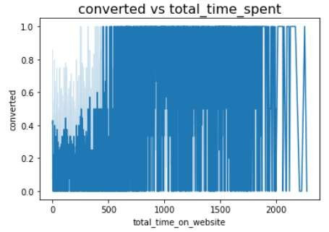
Scatter plot for converted vs total_time_spent
I nference:
As the total time spent increases the conversion rate also moves in the same direction and vice – versa.

Slide 21
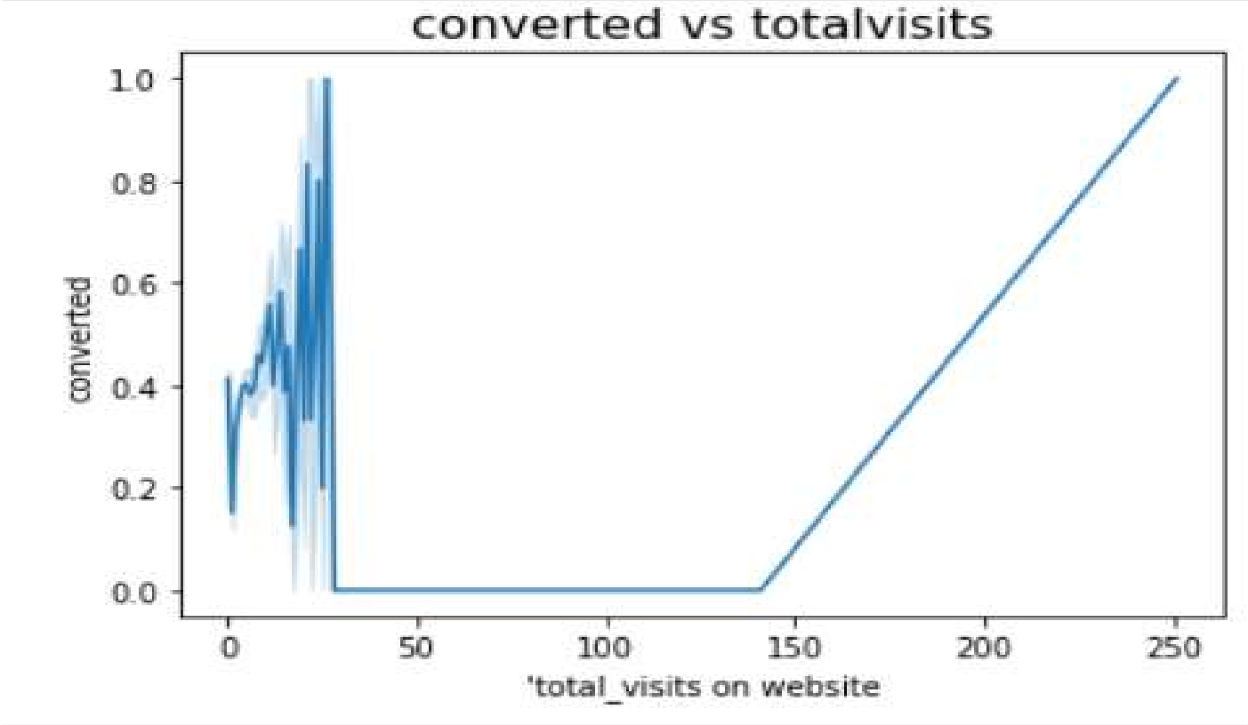
Scatter plot for converted vs total visits
I nference:
The total visits on the website is seen to be increasing with the peak at 40 approx. and further the curve is flat beyond this point.
Again we can observe that, when the total visits on website is around 150 there can be seen a steep increase in the curve upto and beyond 250.

Slide 22
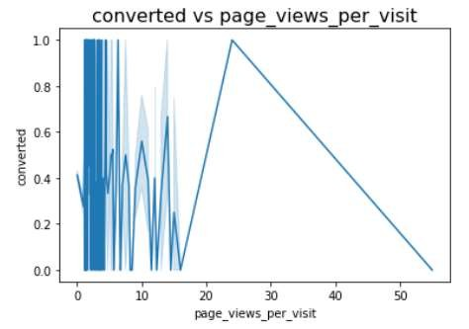
Scatter plot for converted vs page_views_per_visit
I nference:
When the page views per visit falls between 0 to 18 (approx.) , there are a series of highs and lows.
On reaching this point, the curve starts rising and reaches it peak when page views are around 22 and post which the curve declines steeply and falls beyond 50.

Slide 23
Data Preparation for Modeling
Create Dummy Variables:
Independent variables as dummy variables allows easy interpretation and calculation of the odds ratios, which increases the stability and significance of the coefficients.
Label Encoding:
Label encoding is simply converting each value in a column to a number.
We will use label encoding for variables with higher level. This is to avoid drastic increase in data frame size.
Some features have hierarchial categories, which requires ordinal encoding. But then the features will not be scale invariant. It is thus better to one-hot encode all categorical variables
After encoding for dummy variables 98.21% data has been retained

Slide 24



Data Preparation for Modeling
Train- Test Split
The modified ‘ dataset has been split into Train and test dataset in the ratio 70 30
Train dataset has been used to train the model whereas Test dataset has been used to evaluate the model

Slide 25
Model Building: Using logistic Regression
Feature Selection using Recursive Feature Elimination (RFE)
RFE is an optimization technique for finding the best performing subset of features It is based on the idea of repeatedly constructing a model and choosing either the best (based on coefficients), setting the feature aside and then repeating the process with the rest of the features This process is applied until all the features in the dataset are exhausted Features are then ranked according to when they were eliminated.
We ran RFE with 15 variables for further model building process
Insignificant features were dropped one by one after checking the P value and Variance Inflation Factor

Slide 26
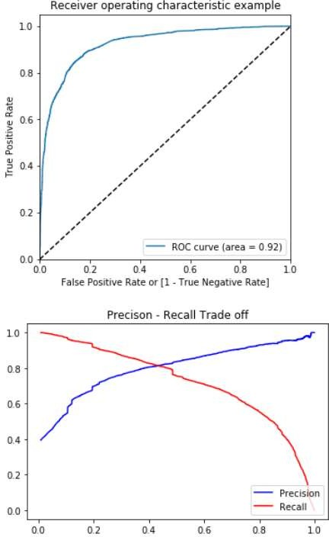




Measuring
Model Performance
Sensitivity (Recall): 0.7563368765331153
Specificity: 0.9075544174135723
Precision: 0.8367254635911352
F-Score: 0.7945028988619283

Slide 27
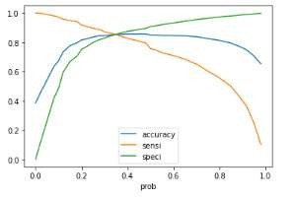

Finding Optimal Cut-off
Optimum cut-off value is: 0.35

Slide 28
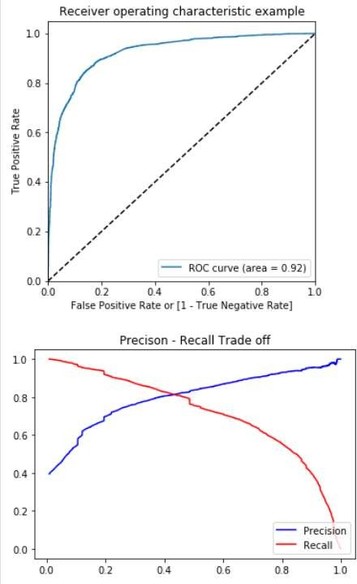





New Predicted Values based on Cut-off
Accuracy: Sensitivity (Recall): 0.8529365454259171 0.8520032706459526
Specificity: Precision: 0.8535211267605634 0.7846385542168675
F-Score: 0.8169345354762838

Slide 29

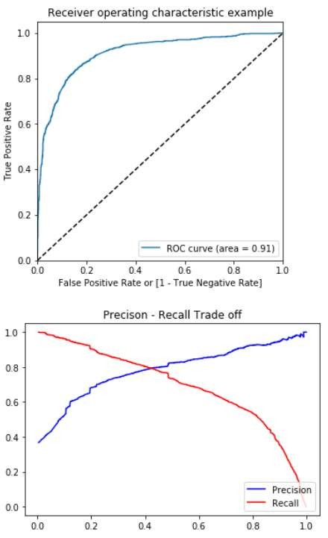
Measuring Performance on Test Set
accuracy: 0.8431876606683805
Sensitivity (Recall): 0.8260869565217391
Specificity: 0.8529411764705882
Precision: 0.7621268656716418
F-Score: 0.7928190198932556
Finally, we have an overall accuracy of approx. 0.84 on our Logistic Regression model. That is, there is around 84% chance that our predicted leads will be converted. This meets the CEO's target of atleast 80% lead conversion.

Slide 30
SUMMARY

Slide 31
Evaluation Metrics
Receiver Operating Characteristics (ROC) Curve:
By determining the Area Under the Curve (AUC) of the ROC curve, the goodness of the model is determined.
Since the ROC curve is close to the upper left part of the graph, it means this model is a very good model.
The value of AUC for our model is 0.92.
Plot accuracy sensitivity and specificity:
•Tradeoff between sensitivity and accuracy can be observed (cutoff = 0.35).
Precision and Recall plot:
Ideal cutoff of 0.43 is observed from recall and precision plot.
We will use both the cutoff and evaluate results for further predictions.

Slide 32

Findings
It was found that the variables that mattered the most in the potential buyers are (In descending order) :
The total time spend on the Website.
Total number of visits.
When the lead source was:
Google
Direct traffic
Organic search
Welingak website
When the last activity was:
SMS
Olark chat conversation
When the lead origin is Lead add format.
When their current occupation is as a working professional. Keeping these in mind the X Education can flourish as they have a very high chance to get almost all the potential buyers to change their mind and buy their courses.

Slide 33
Findings
Following three variables are contributing the most towards the probability of a lead getting converted:
Page_views_per
Lead_quality_not_sure
Total_time_spent
Again, based on the coefficient values the following are the top three categorical/dummy variables that should be focused the most in order to increase the probability of lead conversion :
lead_source_reference
lead_source_welingak_website
last_notable_activity_had_a_phone_conversation

Slide 34
Conclusion and Recommendations
There are a lot of leads generated in the initial stage (top) but only a few of them come out as paying customers from the bottom. In the middle stage, you need to nurture the potential leads well (i.e. educating the leads about the product, constantly communicating etc.) in order to get a higher lead conversion.
First, sort out the best prospects from the leads you have generated. 'TotalVisits' , 'Total Time Spent on Website' , 'Page Views Per Visit' which contribute most towards the probability of a lead getting converted.
Then, You must keep a list of leads handy so that you can inform them about new courses, services, job offers and future higher studies.
Monitor each lead carefully so that you can tailor the information you send to them.
Carefully provide job offerings, information or courses that suits best according to the interest of the leads.
A proper plan to chart the needs of each lead will go a long way to capture the leads as prospects.
Focus on converted leads.
Hold question-answer sessions with leads to extract the right information you need about them.
Make further inquiries and appointments with the leads to determine their intention and mentality to join online courses.

Slide 35
Conclusion and Recommendations
While we have checked both Sensitivity-Specificity as well as Precision and Recall Metrics, we have considered the optimal cut off based on Sensitivity and Specificity for calculating the final prediction.
Accuracy, Sensitivity and Specificity values of test set are around 84%, 83% and 85% which are approximately closer to the respective values calculated using trained set.
Also the lead score calculated in the trained set of data meets 80% Lead Conversion.
Hence overall this model seems to be good.

Slide 36
THANK YOU

